Slide 1
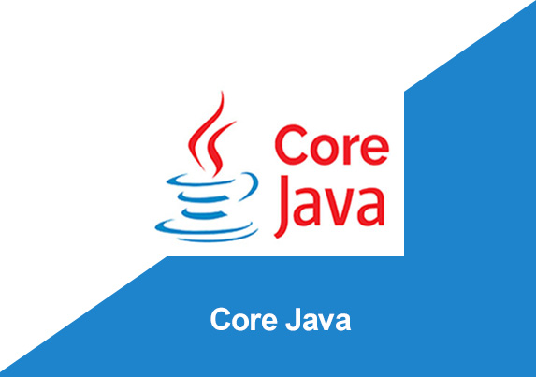
By: Manas Tuwani

Slide 2
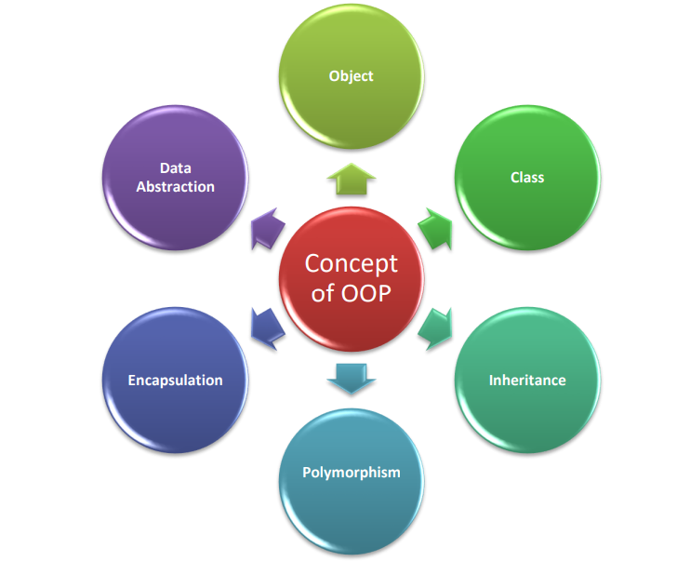
OOPs (Object-Oriented Programming System)
Object means a real-world entity such as a pen, chair, table, computer, watch, etc. Object-Oriented Programming is a methodology to design a program using classes and objects. It simplifies software development and maintenance by providing some concepts:

Slide 3
OOPS CONCEPTS
Java is the object-oriented programming language. It supports the below concepts.
1. Class
2. Object
3. Package
4. Inheritance
5. Polymorphism
6. Encapsulation
7. Abstraction

Slide 4
Inheritance
The idea behind inheritance in Java is that you can create new classes that are built upon existing classes. When you inherit from an existing class, you can reuse methods and fields of the parent class. Moreover, you can add new methods and fields in your current class also.
Inheritance represents the IS-A relationship which is also known as a parent-child relationship.

Slide 5
Inheritance
Inheritance: it defines inheriting the behaviour (Members) of one class to another class.
Child class object will inherit the properties of parent class.
Java supports 4 different types of inheritance.
1. Single Inheritance
2. Multi-Level Inheritance
3. Hierarchical Inheritance
4. Hybrid Inheritance

Slide 6
Single Level Inheritance
In this we are inheriting the behaviour from one class to another class (Parents to Children)
Note:
In inheritance we can inherit the behaviour of one class to another class by using “Extends” Keyword.

Slide 7
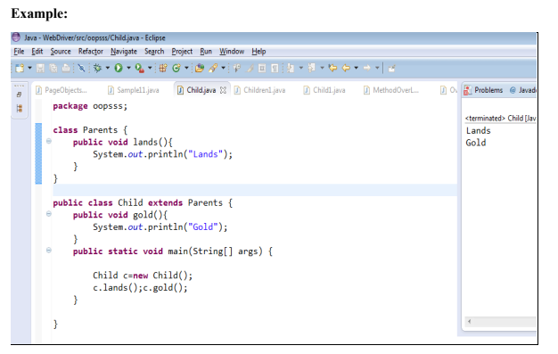

Slide 8
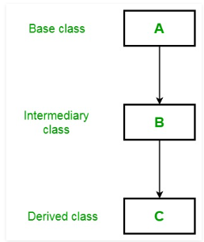
Multi-Level Inheritance
In Multi-level Inheritance we are inheriting properties from one class to another and into another class (Grand Parents to Parents and Parents to Children)

Slide 9
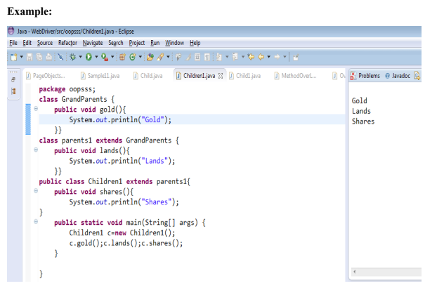

Slide 10
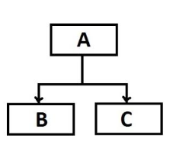
Hierarchical Inheritance
In Hierarchical Inheritance we can inherit the behaviour from one class to multiple classes.

Slide 11
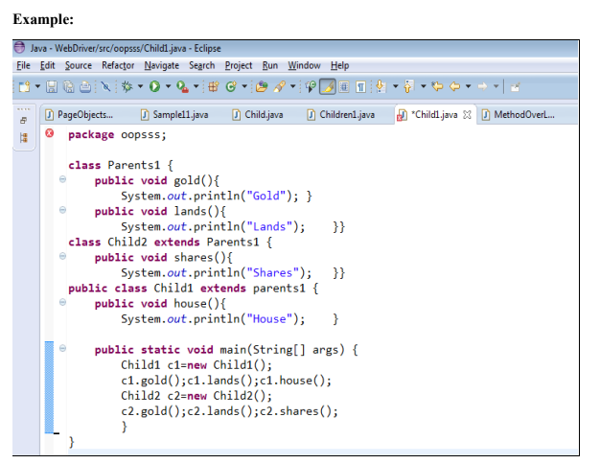

Slide 12
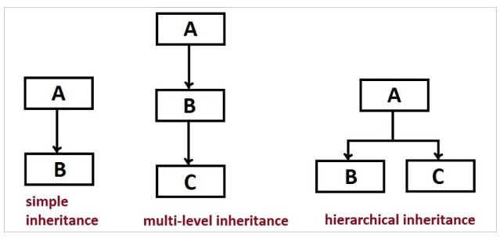

Slide 13
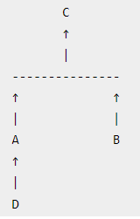
Hybrid Inheritance
Hybrid Inheritance is combination of Multi Level and Hierarchical Inheritance in Java

Slide 14
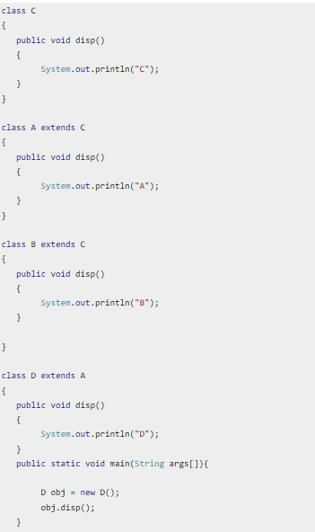

Slide 15
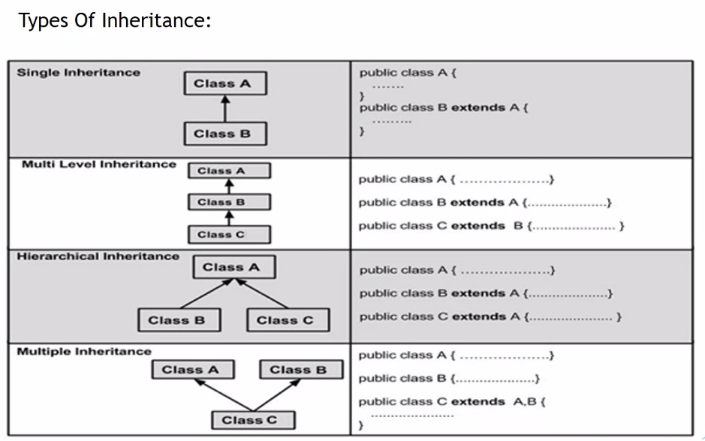

Slide 16
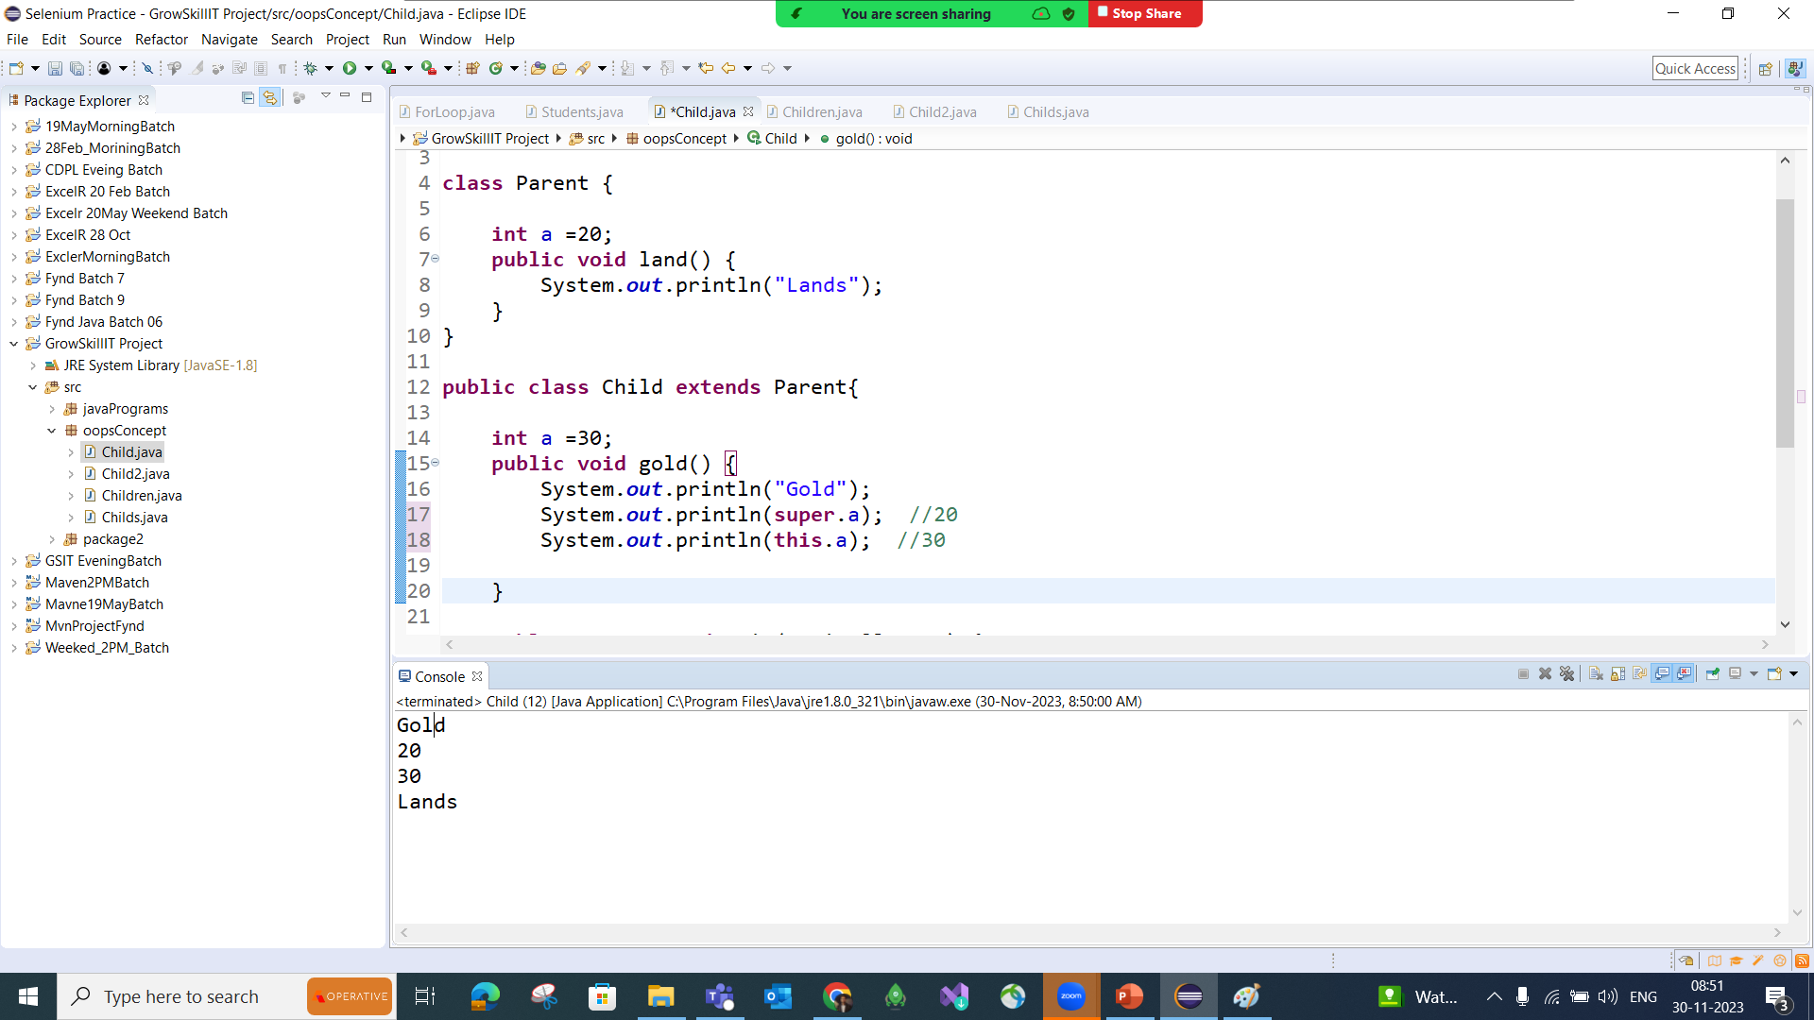
this and super Keyword in Java

